Slide 1
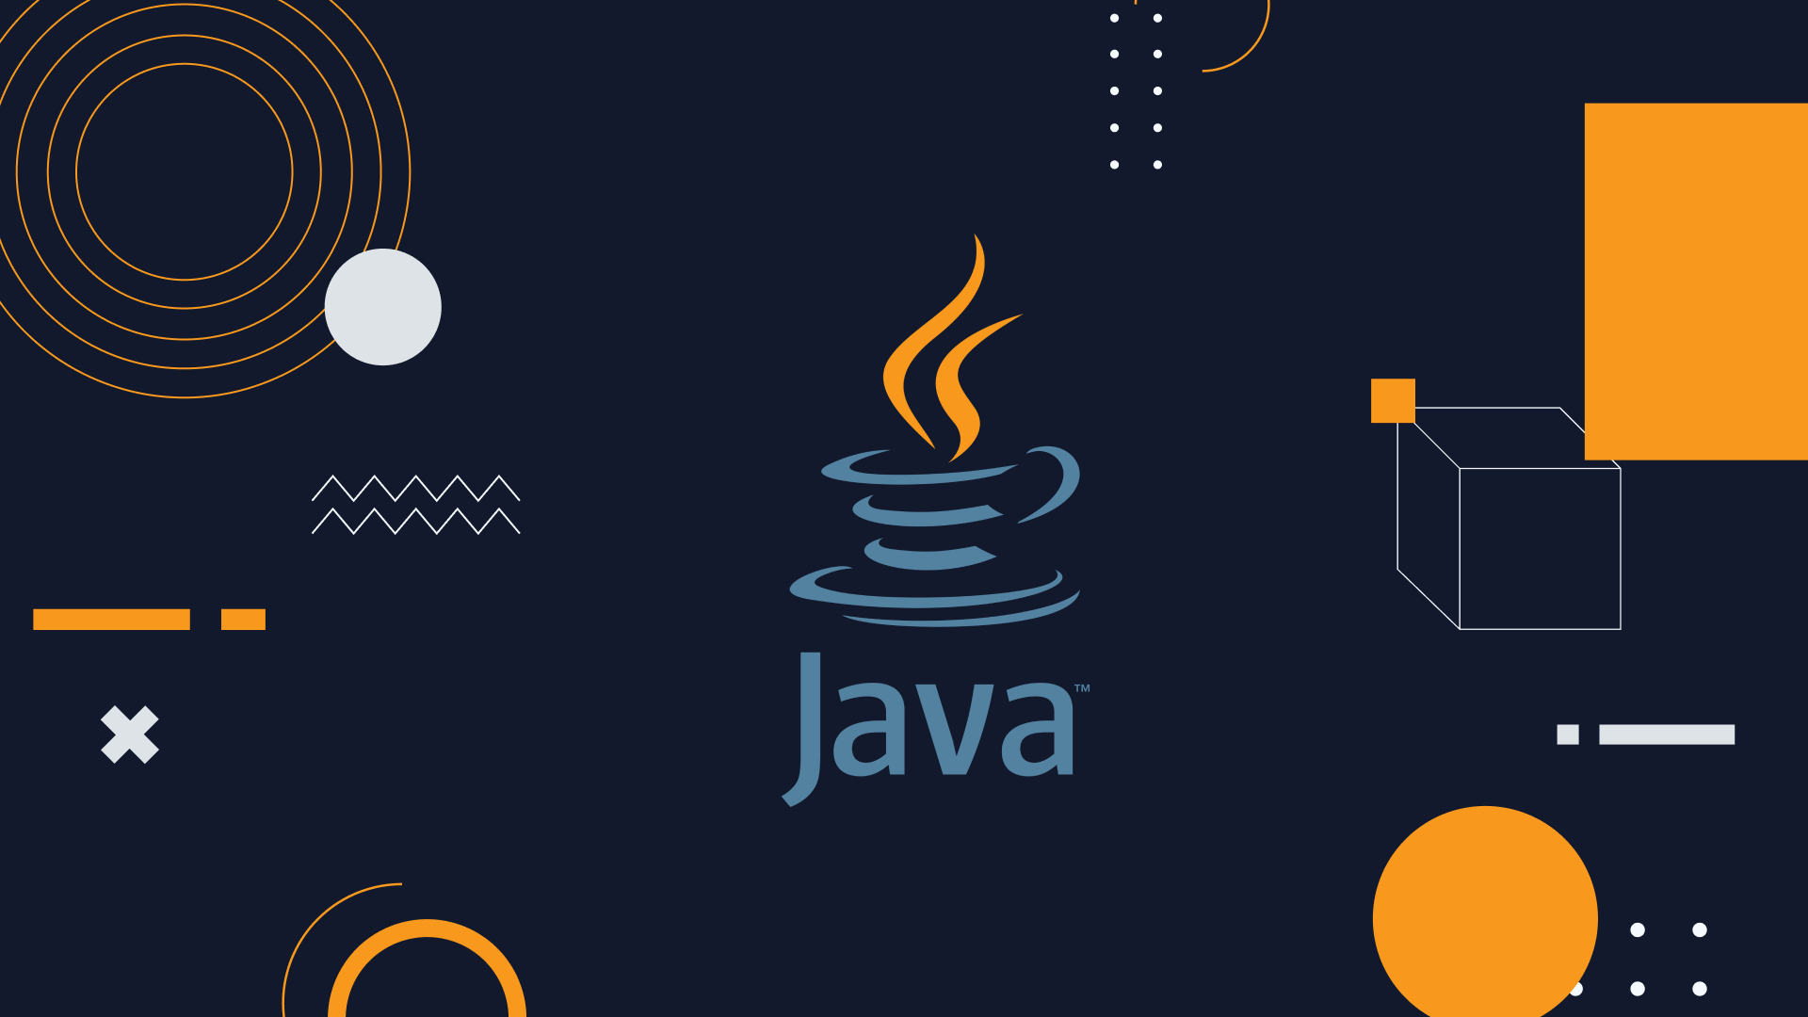

Slide 2
What is Java?
Java is a programming language and a platform.
Java is a high level, robust, object-oriented and secure programming language.
It is a computing platform for application development.
Java is fast, secure, and reliable.
It is widely used for developing Java applications in laptops, data centers, game consoles, scientific supercomputers, cell phones, etc.
Java slogan is Write Once & run Anywhere.
Java is free to download for personal use.

Slide 3
There are many devices where Java is currently used. Some of them are as follows
Desktop Applications such as acrobat reader, media player, antivirus, etc.
Web Applications such as irctc.co.in etc.
Enterprise Applications such as banking applications.
Mobile
Embedded System
Smart Card
Robotics
Games, etc.

Slide 4
History of Java
was developed by James Gosling, who is known as the father of Java, in 1995.
James Gosling and his team members started the project in the early '90s.
Why had they chosen the name Java for Java language? The team gathered to choose a new name. The suggested words were "dynamic", "revolutionary", "Silk", "jolt", "DNA", etc.
They wanted something that reflected the essence of the technology: revolutionary, dynamic, lively, cool, unique, and easy to spell, and fun to say.
According to James Gosling, "Java was one of the top choices along with Silk".

Slide 5
Since Java was so unique, most of the team members preferred Java than other names.
Java is an island in Indonesia where the first coffee was produced (called Java coffee).
It is a kind of espresso bean. Java name was chosen by James Gosling while having a cup of coffee nearby his office.

Slide 6
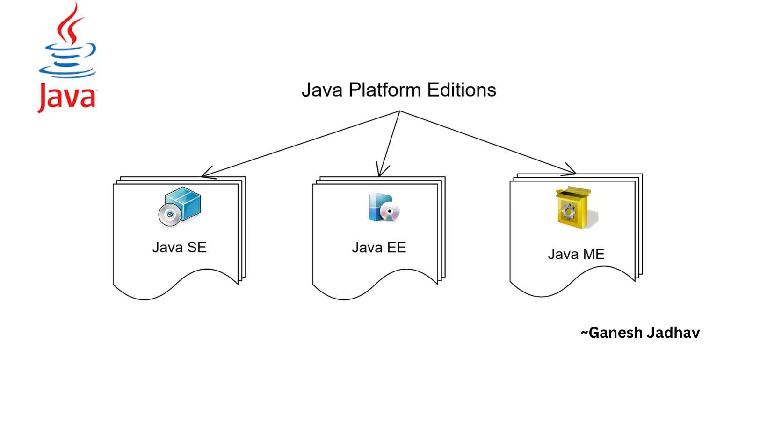

Slide 7
Java Platforms / Editions
1) Java SE (Java Standard Edition)
It is a Java programming platform. It includes Java programming APIs such as java.lang, java.io, java.net, java.util, java.sql, java.math etc.
It includes core topics like OOPs, String, Regex, Exception, Inner classes, Multithreading, I/O Stream, Networking, AWT, Swing, Reflection, Collection, etc.
2) Java EE (Java Enterprise Edition)
It is an enterprise platform that is mainly used to develop web and enterprise applications. It is built on top of the Java SE platform.
It includes topics like Servlet, JSP, Web Services, EJB, JPA, etc.

Slide 8
3) Java ME (Java Micro Edition)
It is a micro platform that is dedicated to mobile applications.
4) JavaFX
It is used to develop rich internet applications. It uses a lightweight user interface

Slide 9
What is Java Compiler?
A compiler in Java is a computer program that is used for compiling Java programs.
It is platform-independent. It converts (translates) source code (.java file) into bytecode (.class file).
In other words, the compiler (javac.exe) generates bytecode during the compilation process.
It is unreadable by humans because it is composed of numbers that are the only language that computers understand.
Java compiler can be activated by using “Javac.exe” command from the command prompt.

Slide 10
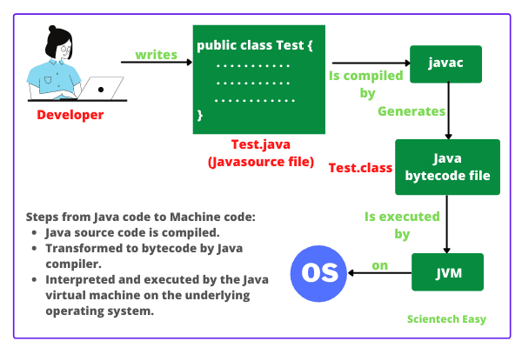
How does Java compiler work?

Slide 11
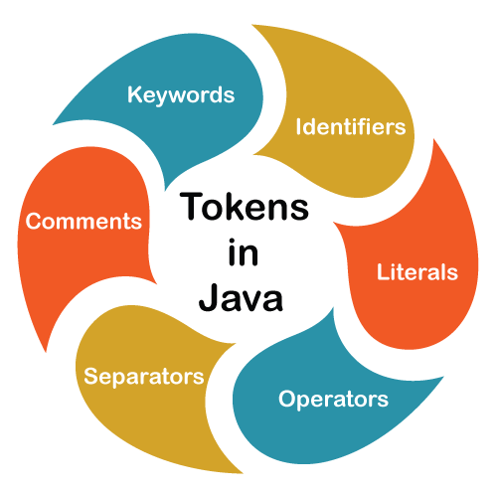

Slide 12
Tokens in Java | Types of Tokens
A java program is basically made up of a group of classes and methods.
A class is a container that contains a set of declaration statements and methods containing executable statements.
A statement consists of variables, constants, operators, keywords, comments, identifier etc.
When the program is run, comments are stripped, and executable statements are executed.
The output is called translation unit.
A translation unit is a sequence of tokens: symbols, numbers, and words.

Slide 13
What are tokens in Java?
Tokens are the various elements in the java program that are identified by Java compiler.
A token is the smallest individual element (unit) in a program that is meaningful to the compiler.
In simple words, a java program is a group of tokens, comments, and white spaces.
final double a = 3.14;
Let us consider the first statement, which is made up of six tokens: “final”, “double”, “p”, “=”, “3.14”, and “;”.
Types of Tokens
Keywords
Identifiers
Literals
Operators

Slide 14
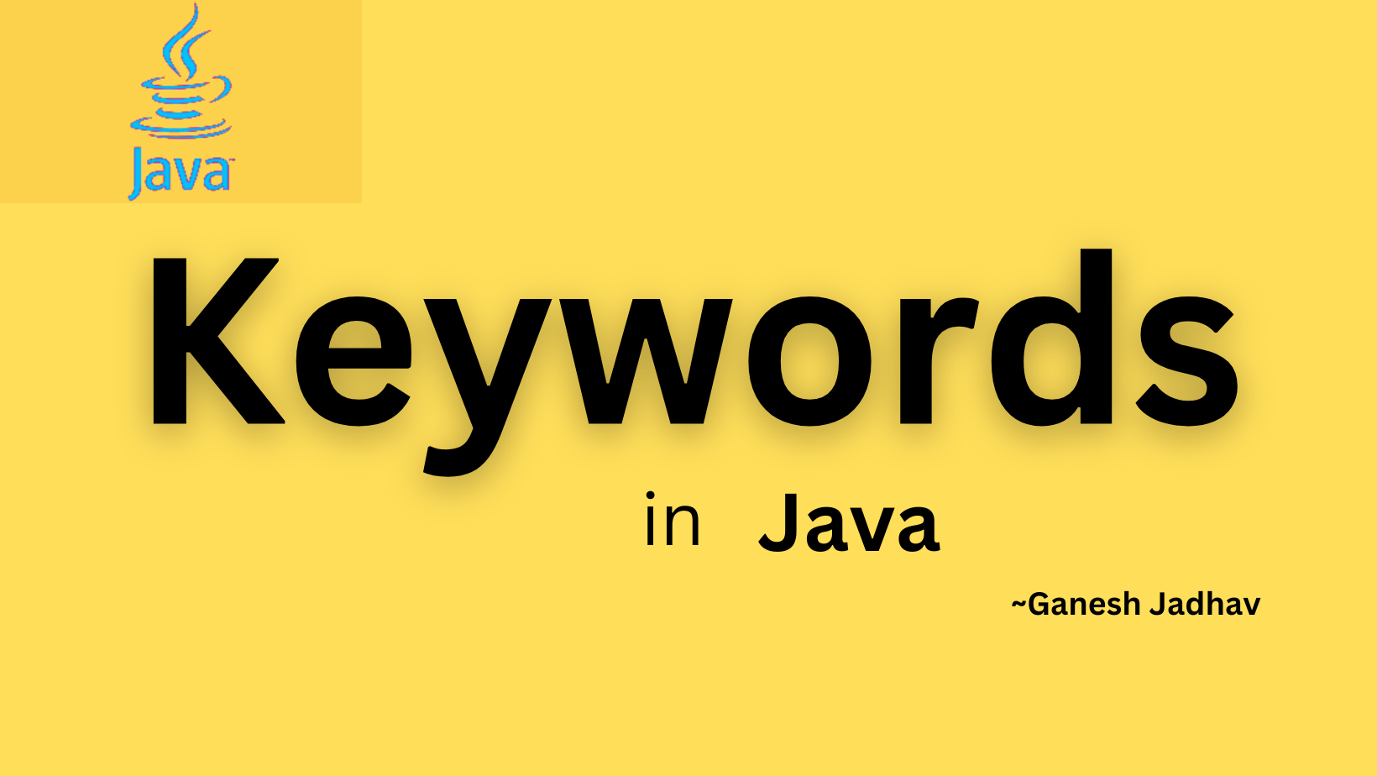

Slide 15
Keywords
Java reserved keywords are predefined words, which are reserved for any functionality or meaning.
We can not use these keywords as our identifier names, such as class name or method name.
These keywords are used by the syntax of Java for some functionality. If we use a reserved word as our variable name, it will throw an error.
Java has 53 word are reserved.
Although the const and goto are not part of the Java language. But they are also considered keywords. This two are the unused keywords.
We are having null reserved keyword as well.

Slide 16
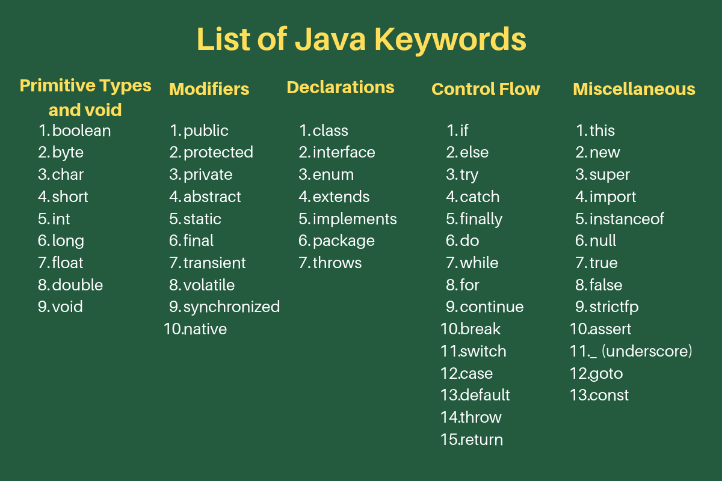

Slide 17
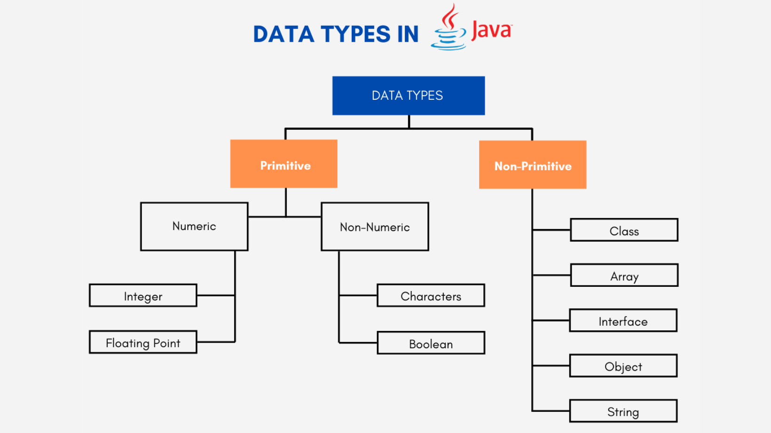

Slide 18
Data Type
Data types specify the different sizes and values that can be stored in the variable. There are two types of data types in Java.
Primitive data types: The primitive data types include boolean, char, byte, short, int, long, float and double.
Non-primitive data types: The non-primitive data types include Classes, Interfaces, and Arrays, String.
Primitive data types
a. boolean data type b. byte data type c. char data type
c. short data type d. int data type e. long data type
f. float data type g. double data type

Slide 19
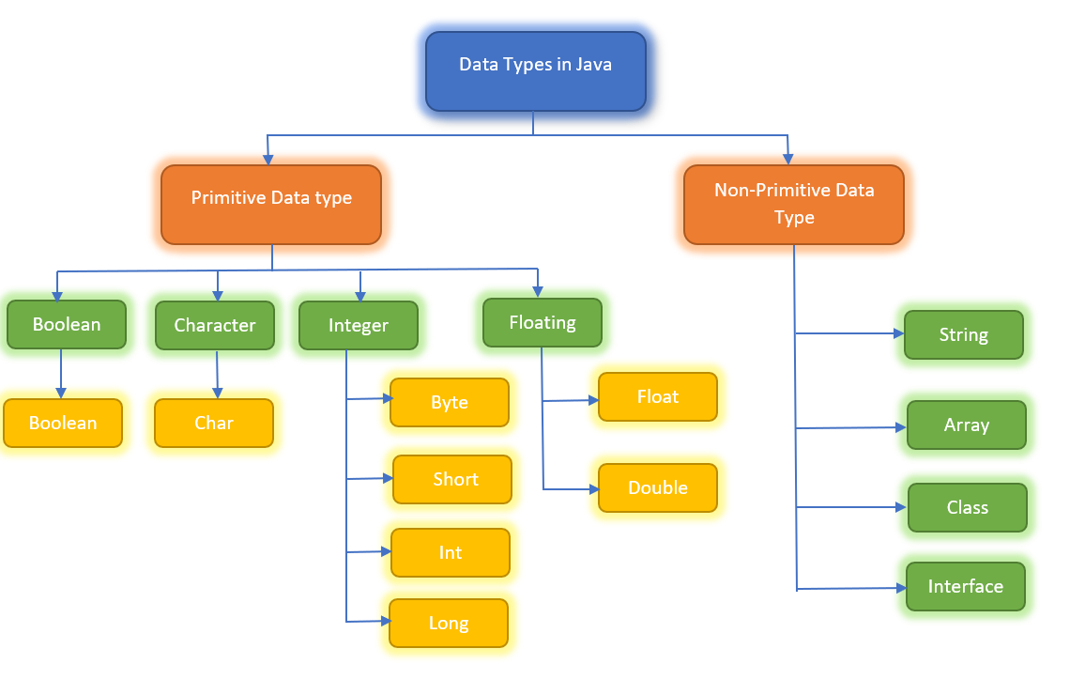

Slide 20
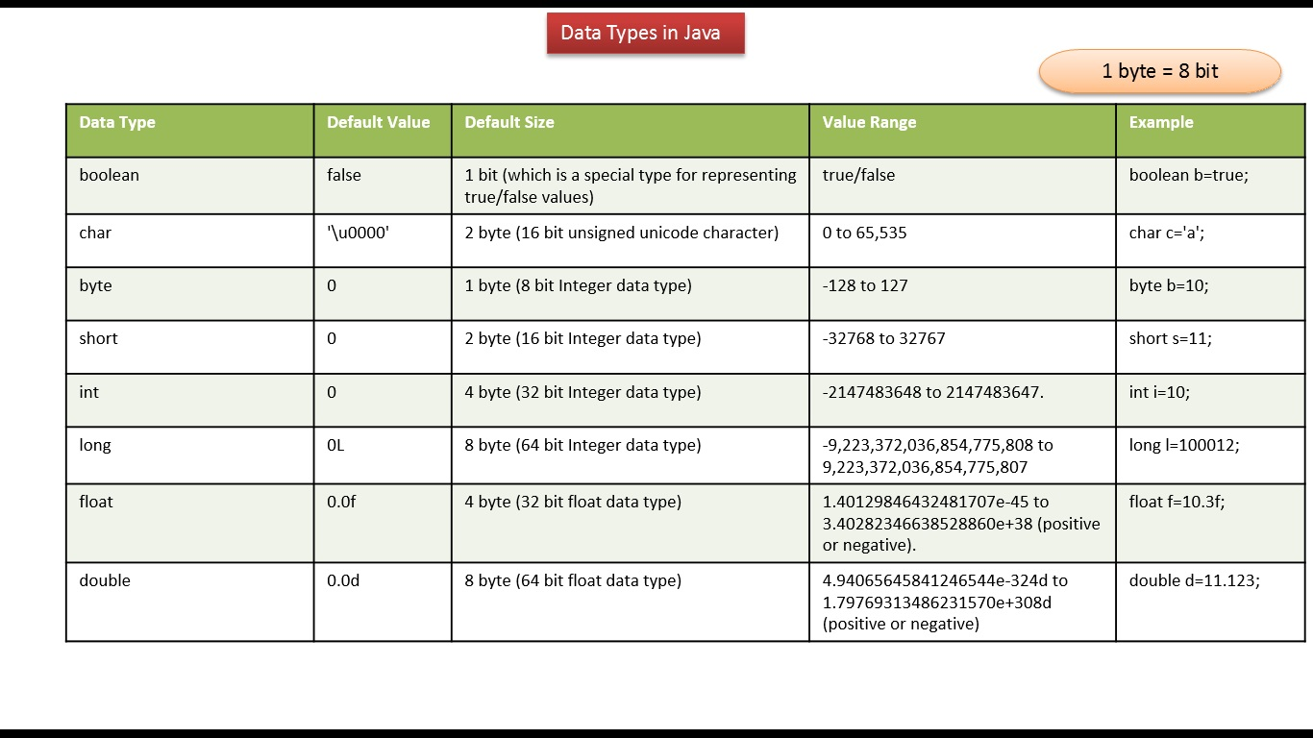

Slide 21
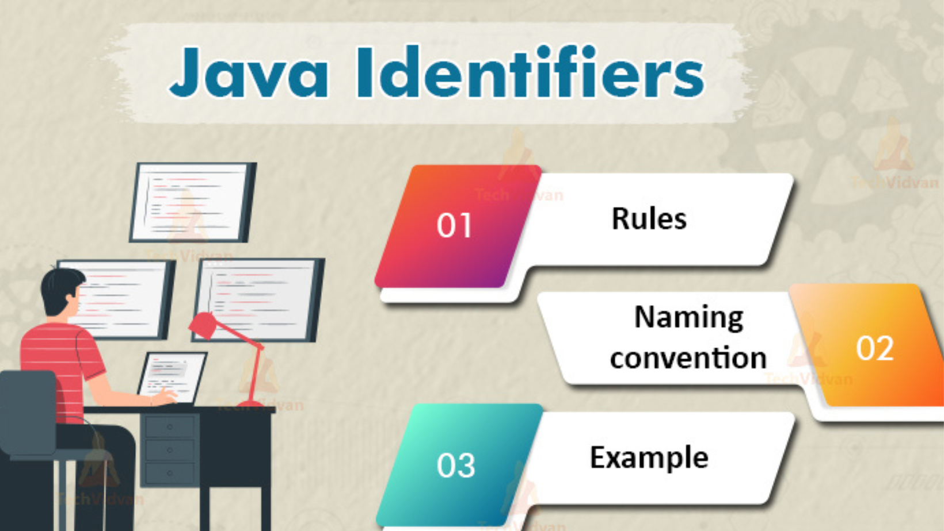

Slide 22
Identifiers
Identifiers in Java are symbolic names used for identification.
They can be a class name, variable name, method name, package name, constant name, and more.
However, In java there are some reserved words that can not be used as an identifier.
HelloJava (Class name)
main (main method)
String (Predefined Class name)
args (String variables)
System (Predefined class)
out (Variable name)
println (method)

Slide 23
Rules for Identifiers in Java
There are some rules and conventions for declaring the identifiers in Java.
If the identifiers are not properly declared, we may get a compile-time error.
Following are some rules and conventions for declaring identifiers.
Rule
A valid identifier must have characters [A-Z].
A valid identifier must have characters [a-z].
A valid identifier must have numbers [0-9] but with characters only.
Valid identifier will be an underscore(_) or a dollar sign ($). (Ganesh_Ja$dhav)
There should not be any space in an identifier.

Slide 24
An identifier should not contain a number at the starting. For example, 123digitalPartner is an invalid identifier.
There is no length limit for java identifiers, but it is not recommended to take to lengthy identifiers. Because it’s reduced the readability.
We can't use the Java reserved keywords as an identifier such as int, float, double, char, etc. For example, int double is an invalid identifier in Java.

Slide 25
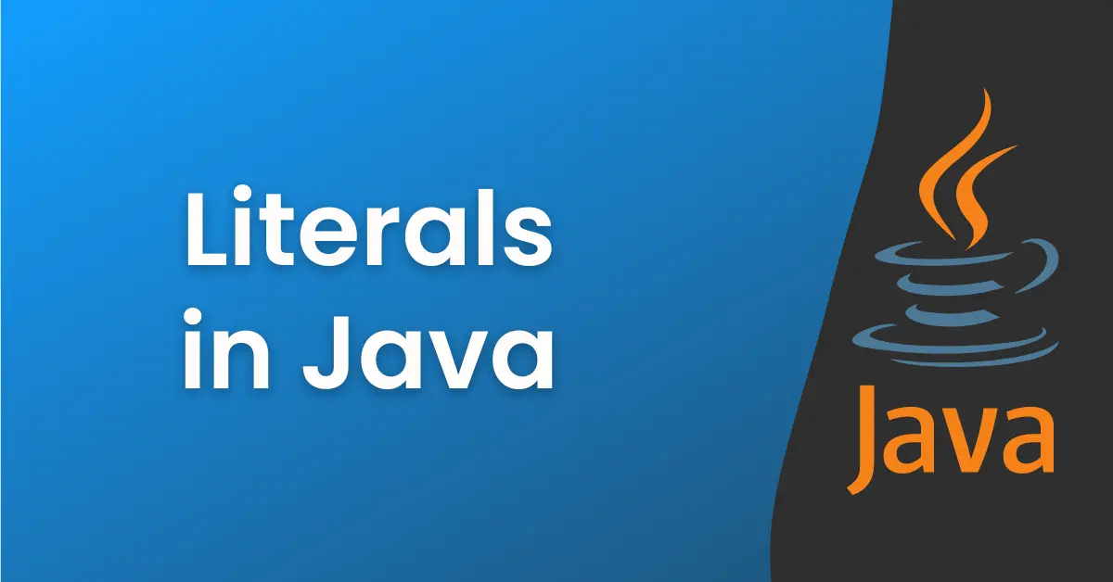

Slide 26
Literals
In Java, literal is a notation that represents a fixed value in the source code.
In lexical analysis, literals of a given type are generally known as tokens.
In Java, literals are the constant values that appear directly in the program.
It can be assigned directly to a variable. Java has various types of literals.
int x = 10; (int – primitive data/key, x = variable, 10 = constant/literals)
Types of Literals in Java
Integral Literal
Character Literal
Boolean Literal
String Literal

Slide 27
Integer Literals
For Integral data types (byte, short, int, long), we can specify literals in 4 ways:-
Decimal literals (Base 10):
Octal literals (Base 8):
Hexa-decimal literals (Base 16)
Binary literals (Base 2)

Slide 28
Decimal literals (Base 10)
In this form, the allowed digits are 0-9. int x = 101;
Octal literals (Base 8)
In this form, the allowed digits are 0-7.
The octal number should be prefix with 0. int x = 0146;

Slide 29
Hexa-decimal literals (Base 16)
In this form, the allowed digits are 0-9, and characters are a-f.
We can use both uppercase and lowercase characters as we know that java is a case-sensitive programming language, but here java is not case-sensitive.
The hexa-decimal number should be prefix with 0X or 0x. int x = 0X123Face;
Binary literals
From 1.7 onward, we can specify literal value even in binary form also, allowed digits are 0 and 1.
Literals value should be prefixed with 0b or 0B. int x = 0b1111;

Slide 30
Floating Point Literals
For Floating-point data types, we can specify literals in only decimal form, and we can't specify in octal and Hexadecimal forms.
Decimal literals(Base 10): In this form, the allowed digits are 0-9.
Float f = 123.4567;
Double d = 123.456;
Double D = 123.4560;
By default, every floating-point literal is of double type, and hence we can't assign directly to the float variable.
we can specify floating-point literal as float type by suffixed with f or F.
We can specify explicitly floating-point literal as double type by suffixed with d or D.

Slide 31
Char literal as Integral literal
we can specify char literal as integral literal.
which represents the Unicode value of the character.
Integral literal can be specified either in Decimal, Octal, and Hexadecimal forms.
But the allowed range is 0 to 65535.

Slide 32
Java ASCII Table
ASCII stands for American Standard Code for Information Interchange.
ASCII is a standard data-transmission code that is used by the computer for representing both the textual data and control characters.
ASCII is a 7-bit character set having 128 characters, i.e., from 0 to 127.
ASCII represents a numeric value for each character, such as 65 is a value of A.
In our Java program, we need to manipulate characters that are stored in ASCII.
https://www.cs.cmu.edu/~pattis/15-1XX/common/handouts/ascii.html

Slide 33
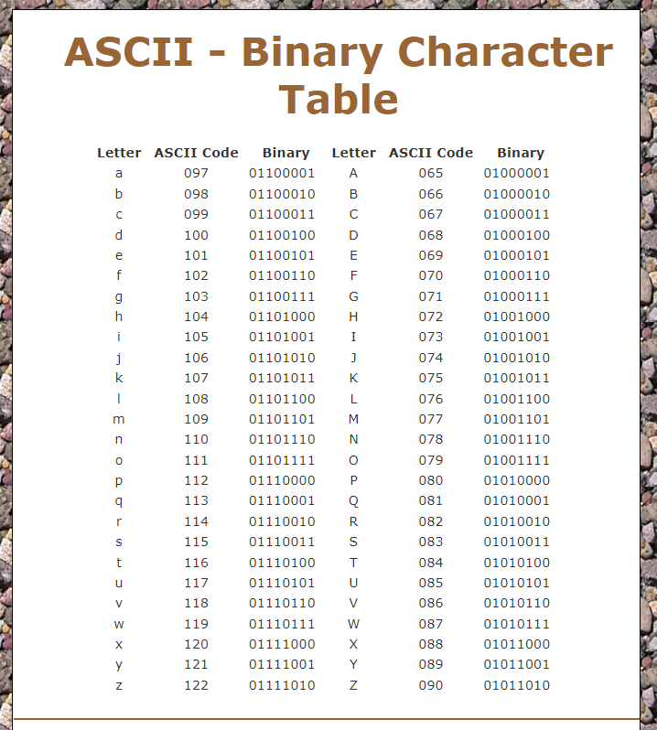

Slide 34
String Literals
Strings, which are widely used in Java programming, are a sequence of characters.
In Java programming language, strings are treated as objects.
The Java platform provides the String class to create and manipulate strings.
Any sequence of character within double quotes is treated as a String Literal.
String s = “Hello Word”
Boolean Literals
Only two values are allowed for Boolean literals, i.e., true and false.
boolean b = true;

Slide 35
Backslash Literals
Java supports some special backslash character literals known as backslash literals.
They are used in formatted output. For example:
\n: It is used for a new line
\t: It is used for horizontal tab
\': It is used for a single quote
\": It is used for double quotes

Slide 36
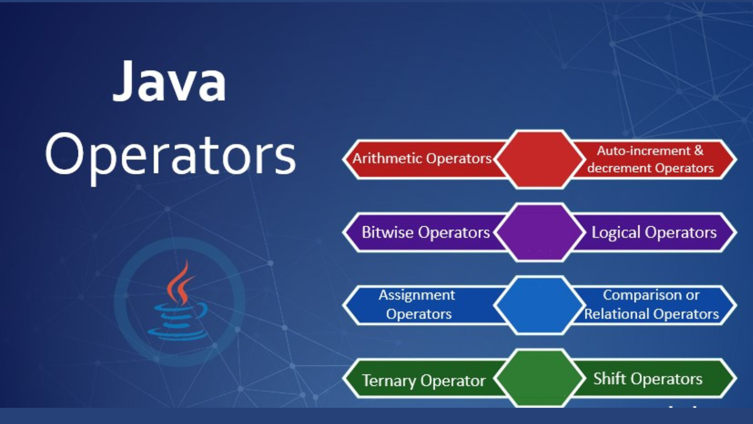

Slide 37
Operators
Operator in Java is a symbol that is used to perform operations. For example: +, -, *, /
There are many types of operators in Java which are given below:
Operator Type | Category | Precedence
Unary | postfix | expr++ expr--
 | prefix | ++expr --expr
Arithmetic | multiplicative | * / %
 | additive | + -
Relational | comparison | < > <= >=
 | equality | == !=
Logical | logical AND | &&
 | logical OR | ||

Slide 38
Unary Operator (++ and –)
incrementing/decrementing a value by one.
We can apply increment & decrement operators only for variable but not for constant values.
If we are trying to apply for constant value, then we will get compile time error.
We can apply incremental or decremental to every primitive datatype except Boolean.
Ex. 1. Int x = 10;
Int y = ++x;
Listing of increment & decrement operator not allowed.
Ex. Int x = 10;
Int y = ++(++x); => You will get unexpected error.

Slide 39
Arithmetic Operators (+, - , *, /, %)
If we applied any arithmetic operator between two variables a & b the results.
Max(int, type of a, type of b)
Byte + byte = int
Byte + short = int
Short + short = int
Byte + long = long
Long + double = double
Float + long = float
Float + char = float
Char + char = int
Char + double = double

Slide 40
String concatenation operator (+)
The Only overload operator in java is + operator.
Sometimes it acts as arithmetic addition operator & sometimes it act as string concatenation operator.
If at least one arguments is string type the operator act as concatenation operator & if both operator arguments are number type, then operator act as arithmetic addition operator.
Ex. String a = “Ganesh”
Int b = 10, c= 20, d = 30;
Sout(a+b+c+d); -> Ganesh102030
Sout(b+c+d+a); -> 60Ganesh
Sout(b+c+a+d); -> 30Ganesh30
Sout(b+a+c+d); -> 10Ganesh2030

Slide 41
Relational Operators : (<, <=, >, >=)
We can apply relational operator for every primitive type except Boolean.
Sout(10<20); -> true
sout(‘a’<10); -> false
sout(‘a’<97.6) -> true
sout(‘a’ > ‘A’) -> true
sout(true > false) -> Compile Time Error
We can’t apply relational operator for object type.
Ex. Sout(“ganesh20215” > “ganesh”) -> Compilation Error
Listing of relational operator is not allowed otherwise we will get compiled time error.
sop(10<20<30); Compilation Error

Slide 42
Equality Operators (==, !=)
We can apply equality operators for every primitive type including Boolean type as well.
Ex. Sout (10 == 20); ->False
sout (‘a’ ==‘b’ ); -> false
sout(‘a’==97.0); -> true
sout(false == false) -> true
Short-circuits Operators(&&, ||)
This is exactly same as bitwise operator.
X && y :- y will be evaluated iff x is a true. i.e. If x is false, then y won’t evaluated.
x ||y :- y will evaluated iff x is false. i.e., if x is true then y won’t be evaluated.

Slide 43
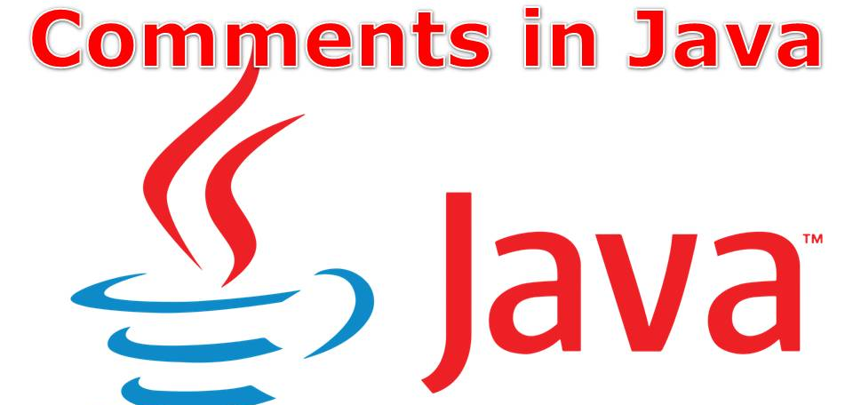

Slide 44
Comments in Java
Comments in Java are statements that describe the features of a program.
It allows the programmers to compose and express their thoughts related to the code independently.
It is a good habit to write comments related to code in a program.
Java comments are not executed by the compiler and interpreter.
They can be used to provide information about variables, methods, classes, or any statement.

Slide 45
Why should we write Comments in Java Program?
We should write comments related to the code because comments help programmers who read your code understand your thoughts.
Increase the readability and understandability of the program. So, if a program is understandable, then it helps others to easily follow our code.
Types of Comments in Java
Single line comment (//)
Multi line comment (/* */)
Java documentation comment (/** */)

